Slide 1
Detecting Phishing Website Using Natural Language Processing and Machine Learning
BATCH A11
R.GIRISWARNA - 211417104067
P.HARINI - 211417104078
GUIDE : M.Sangeetha,M.Tech.,
DOMAIN : MACHINE LEARNING
01

Slide 2
ABSTRACT
Malicious Web sites largely promote the growth of Internet criminal activities and constrain the development of Web services. As a result, there has been strong motivation to develop systemic solution to stopping the user from visiting such Websites.
We propose a learning based approach to classifying Web sites into 3 classes: Benign, Spam and Malicious.
Our mechanism only analyses the Uniform Resource Locator (URL) itself without accessing the content of Web sites.
Thus, it eliminates the run-time latency and the possibility of exposing users to the browser based vulnerabilities.
By employing learning algorithms, our scheme achieves better performance on generality and coverage compared with blacklisting service.
02

Slide 3
Benign: Safe websites with normal services
Spam: Website performs the act of attempting to flood the user with advertising or sites such as fake surveys and online dating etc.
Malware: Website created by attackers to disrupt computer operation, gather sensitive information, or gain access to private computer systems.
URLs of the websites are separated into 3 classes
03

Slide 4
EXISTING SYSTEM
A poorly structured NN model may cause the model to under fit the training dataset. On the other hand, exaggeration in restructuring the system to suit every single item in the training dataset may cause the system to be over fitted .
One possible solution to avoid the Over fitting problem is by restructuring the NN model in terms of tuning some parameters, adding new neurons to the hidden layer or sometimes adding a new layer to the network.
For instance, the model designer may set the acceptable error rate to a value that is unreachable which causes the model to stick in local minima or sometimes the model designer may set the acceptable error rate to a value that can further be improved.
Disadvantages : It will take time to load all the dataset, Process is not accuracy,It will analyse slowly.
04

Slide 5
PROPOSED SYSTEM
Analysing lexical features enables us to capture the property for classification purposes. We first distinguish the two parts of a URL: the host name and the path, from which we extract bag-of-words (strings delimited by ‘/’, ‘?’, ‘.’, ‘=’, ‘-’ and ‘’).
We find that phishing website prefers to have longer URL, more levels (delimited by dot), more tokens in domain and path, longer token. Besides, phishing and malware websites could pretend to be a benign one by containing popular brand names as tokens other than those in second-level domain.
Considering phishing websites and malware websites may use IP address directly so as to cover the suspicious URL, which is very rare in benign case. Also, phishing URLs are found to contain several suggestive word tokens (confirm, account, banking, secure, ebayisapi, webscr, login, sign in)
Advantage: All of URLs in the dataset are labelled
We used two supervised learning algorithms random forest and support vector machine to train using scikit-learn library
05

Slide 6
LITERATURE SURVEY
S.No | Year of Publish | Title and Author | Algorithm | Drawbacks
01 | 2014 | Learning to Detect Phishing URLs - Ram B. Basnet , Andrew H. Sung IJRET , 03(06) | Naıve Bayes | We also do not use DNS entries and geo-locations of pages’ host and name servers that is our major drawbacks.
02 03 | 2011 2016 | Malicious web Page detection based on on-line learning algorithm - Wen Zhang, Yu-Xin Ding, Yan Tang, Bin Zhao IEEE ,10(11) Real Time Detection of Phishing Website - Ahmed,Abdullah IEEE ,7(11) | CV algorithm, PV algorithm, online learning algorithms content-based, heuristic-based and blacklist-based approaches | The weight of features is decided by the difference of feature frequency in malicious and benign samples. Experimental results show that this method can improve the performance of online learning algorithms. Accuracy should be Improved
06
06

Slide 7
04 | 2012 | Holistic Analysis and Detection of Malicious Web pages - Birhanu Eshete, Adolfo Villafiorita , and Komminist Weldemariam International Conference on Security and Privacy in Communication Systems volume:106 | Confidence-Weighted Majority Vote Classification | One limitation of BINSPECT Is lack of analysis of obfuscated JavaScript and emulation of the browser with plugins.
05 | 2018 | Using syntactic for phishing detection-Gilan Mark,Julia M.Taylor IEEE ,10(4) | Heuristic,Blacklist,fuzzy rule based,image processing,CANTINA based approach | Here,there is no classifiers used ,so less prediction
06 | 2015 | S. Marchal, J. Francois, R. State, and T. Engel - Phish Score: Hacking phishers’ minds IEEE, 11(9) | Naive bayes | Less accuracy.
06
07

Slide 8
07 | 2013 | iTrust page:a user assistant anti-phishing tool-ACM, 42(4) | Signature technique, State-change technique (rule-based technique | some further works can be done to improve its Performance.
08 | 2018 | Performance comparison of classifiers on reduced phishing website dataset - M. Karabatak and T. Mustafa IEEE,18(7) | Decision tree, Gradient Boosting, Generalised Addictive Model. | More accuracy needed.
09 | 2010 | Phishing Detection:A Literature Survey-M.Khonji,Y.Iraq IEEE,13(4) | C4.5 algorithm, Svm,naïve bayes, Decision tree | We abandon the features relative with the analysis of web content.
10 | 2018 | Online Phishing Classification Using Adversarial Data Mining and Signaling Games- Gaston L’Huillier, Richard Weber, N.Figueroa ACM, 28(9) | Decision Tree | Less performance
08

Slide 9
PROBLEM STATEMENT
While the Internet has brought unprecedented convenience to many people for managing their finances and investments, it also provides opportunities for conducting fraud on a massive scale with little cost to the fraudsters.
Fraudsters can manipulate users instead of hardware/software systems, where barriers to technological compromise have increased significantly. Phishing is one of the most widely practised Internet frauds.
It focuses on the theft of sensitive personal information such as passwords and credit card details.
Phishing attacks take two forms:
attempts to deceive victims to cause them to reveal their secrets by pretending to be trustworthy entities with a real need for such information
attempts to obtain secrets by planting malware onto victims’ machines.
09

Slide 10
HARDWARE / SOFTWARE
SOFTWARE
HARDWARE
Windows 7 or higher
Python 2.7
Anaconda Navigator
Python’s standard library
Pandas
Numpy
Sklearn
tkMessageBox
Dataset of Phishing websites
Intel 1.66 Ghz processor pentium 4
RAM 4GB(minimum)
100GB HDD
Internet Connectivity
10

Slide 11
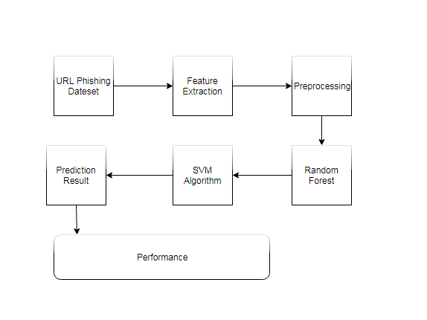
SYSTEM ARCHITECTURE
11

Slide 12
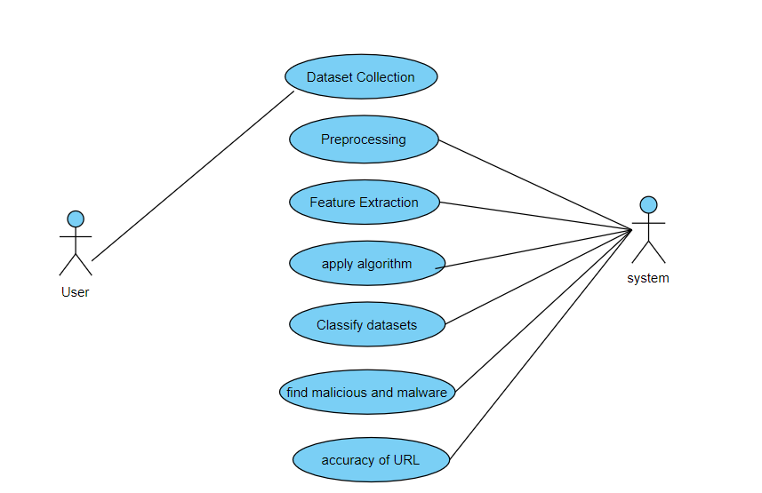
Use case Diagram
12

Slide 13
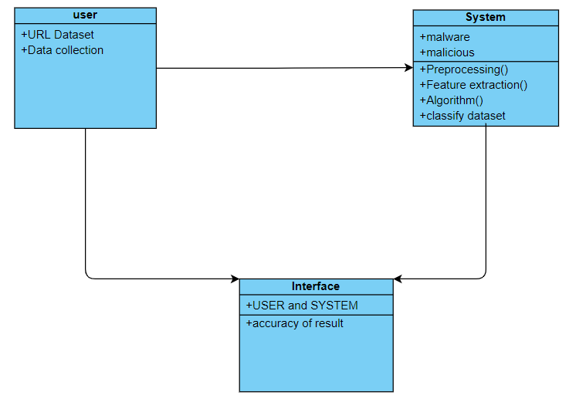
Class Diagram
13

Slide 14
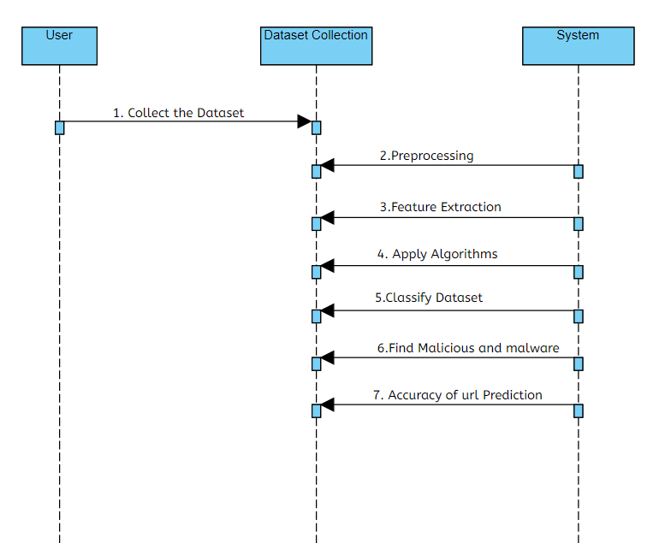
Sequence Diagram
14

Slide 15
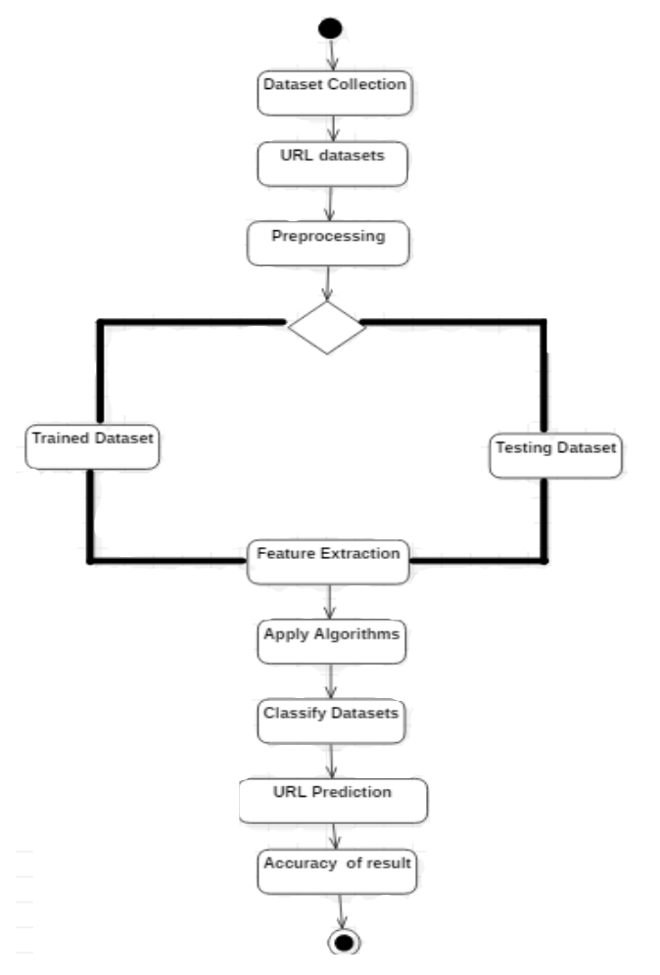
Activity Diagram
15

Slide 16
Modules
1. Phishing Websites Features
One of the challenges faced by our research was the unavailability of reliable training datasets. In fact, this challenge faces any researcher in the field. However, although plenty of articles about predicting phishing websites using data mining techniques have been disseminated these days, no reliable training dataset has been published publicly, maybe because there is no agreement in literature on the definitive features that characterize phishing websites, hence it is difficult to shape a dataset that covers all possible features.
In this article, we shed light on the important features that have proved to be sound and effective in predicting phishing websites. In addition, we proposed some new features, experimentally assign new rules to some well-known features and update some other features.
16

Slide 17
1.1. Address Bar based Features
1.1.1.Using the IP Address
If an IP address is used as an alternative of the domain name in the URL, such as “http://125.98.3.123/fake.html”, users can be sure that someone is trying to steal their personal information. Sometimes, the IP address is even transformed into hexadecimal code as shown in the following link “http://0x58.0xCC.0xCA.0x62/2/paypal.ca/index.html”
Rule: IF{ If The Domain Part has an IP Address → Phishing
Otherwise → Legitimate
1.1.2..Long URL to Hide the Suspicious Part
Rule: IF{ 𝑈𝑅𝐿 𝑙𝑒𝑛𝑔𝑡ℎ < 54 → 𝑓𝑒𝑎𝑡𝑢𝑟𝑒 = Legitimate
𝑒𝑙𝑠𝑒 𝑖𝑓 𝑈𝑅𝐿 𝑙𝑒𝑛𝑔𝑡ℎ ≥ 54 𝑎𝑛𝑑 ≤ 75 → 𝑓𝑒𝑎𝑡𝑢𝑟𝑒 = 𝑆𝑢𝑠𝑝𝑖𝑐𝑖𝑜𝑢𝑠
𝑜𝑡ℎ𝑒𝑟𝑤𝑖𝑠𝑒 → 𝑓𝑒𝑎𝑡𝑢𝑟𝑒 = Phishing
1.1.3.Using URL Shortening Services “TinyURL”
Rule: IF{ TinyURL → Phishing
Otherwise → Legitimate
17

Slide 18
1.1.4. URL’s having “@” Symbol
Using “@” symbol in the URL leads the browser to ignore everything preceding the “@” symbol and the real address often follows the “@” symbol.
Rule: IF { Url Having @ Symbol → Phishing
Otherwise → Legitimate
1.1.5.Redirecting using “//”
The existence of “//” within the URL path means that the user will be redirected to another website. An example of such URL’s is: “http://www.legitimate.com//http://www.phishing.com”. We examine the location where the “//” appears. We find that if the URL starts with “HTTP”, that means the “//” should appear in the sixth position. However, if the URL employs “HTTPS” then the “//” should appear in seventh position.
Rule: IF { The Position of the Last Occurrence of "//" in the URL > 7 → Phishing
Otherwise → Legitimate
1.1.6.Adding Prefix or Suffix Separated by (-) to the Domain
For example http://www.Confirme-paypal.com/.
Rule: IF { Domain Name Part Includes (−) Symbol → Phishing
Otherwise → Legitimate
18

Slide 19
1.1.7. Domain Registration Length
Based on the fact that a phishing website lives for a short period of time, we believe that trustworthy domains are regularly paid for several years in advance. In our dataset, we find that the longest fraudulent domains have been used for one year only.
Rule: IF{ Domains Expires on ≤ 1 years → Phishing
Otherwise → Legitimate
2. Using Pop-up Window
It is unusual to find a legitimate website asking users to submit their personal information through a pop-up window. On the other hand, this feature has been used in some legitimate websites and its main goal is to warn users about fraudulent activities or broadcast a welcome announcement, though no personal information was asked to be filled in through these pop-up windows.
Rule: IF Popup Window Contains Text Fields→ Phishing
Otherwise → Legitimate
19

Slide 20
3. Classification
To ensure that our approach works well irrespective of the underlying classiﬁer chosen for the task, we performed the experiments using two different classiﬁers: Random Forest and Support vector machine, as these are some of the most commonly used classiﬁers for the task of text-data classiﬁcation. Scikit-learn implementation of these classiﬁers with their default parameter settings are used for our experiments.
The tf-idf feature is used to represent each URL in the database.
20

Slide 21
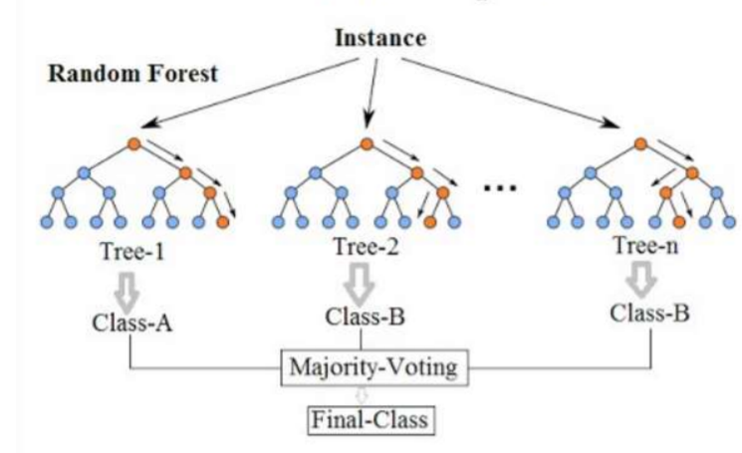
Random Forest
The following are the general steps used in performing the random forest algorithm
1. First take N random set of columns from the dataset, 2. Using these N records Construct a decision tree, 3. Select the number of trees you want in your algorithm and repeat steps 1 and 2, 4. Finally the final class is chosen as the average of all the available classes.
21

Slide 22
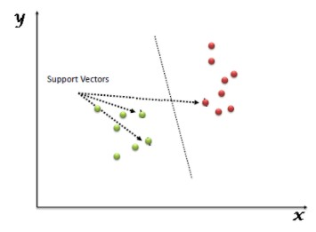
Support Vector Machine
SVM (support vector machines) generally are capable of delivering higher performance in terms of classification accuracy than the other data classification algorithms. It has been employed in a wide range of real world problems such as text categorization, hand-written, digit recognition, tone recognition, image classification and object detection, micro-array gene expression data analysis, data classification . SVM acts as a machine learning based system for the detection of malware .
22

Slide 23
TEST REPORT
S.NO | INPUT | EXPECTED OUTPUT | ACTUAL OUTPUT | STATUS
1 | http://hdfcbank.com | The URL http://hdfcbank.com is benign | The URL http://hdfcbank.com is benign | PASSED
2 | http://stackoverflow.com/questions/8551735/how-do-i-run-python-code-from-sublime-text-2 | The URL http://stackoverflow.com/questions/8551735/how-do-i-run-python-code-from-sublime-text-2 is benign | The URL http://stackoverflow.com/questions/8551735/how-do-i-run-python-code-from-sublime-text-2 is benign | PASSED
3 | http://j-heaven.tripod.com/library.htm | The URL http://j-heaven.tripod.com/library.htm is Malware | The URL http://j-heaven.tripod.com/library.htm is Malware | PASSED
4 | http://jam.canoe.ca/movies/artists/g/gottfried_gilbert/1997/02/21/758674.html | The URL http://jam.canoe.ca/movies/artists/g/gottfried_gilbert/1997/02/21/758674.html is Malicious | The URL http://jam.canoe.ca/movies/artists/g/gottfried_gilbert/1997/02/21/758674.html is Malicious | PASSED
5 | http://www.lushmedia.co.uk/ | The URL http://www.lushmedia.co.uk/ is Malware | The URL http://www.lushmedia.co.uk/ is Malware | PASSED
6 | http://timesofindia.com | The URL http://timesofindia.com is benign | The URL http://timesofindia.com is benign | PASSED
23

Slide 24
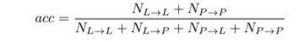
EVALUATION METRICS
The overall accuracy can be detected from confusion matrix.The overall accuracy is calculated by summing the number of correctly classified values and dividing by the total number of values. The correctly classified values are located along the upper-left of the confusion matrix. The total number of values is the number of values in either the truth or predicted-value arrays.
Here,NL→L be the number of legitimate websites classified as legitimate, NL→P be the number of legitimate websites misclassified as phishing, NP→L be the number of phishing misclassified as legitimate and NP→P be the number of phishing websites classified as phishing.
24

Slide 25
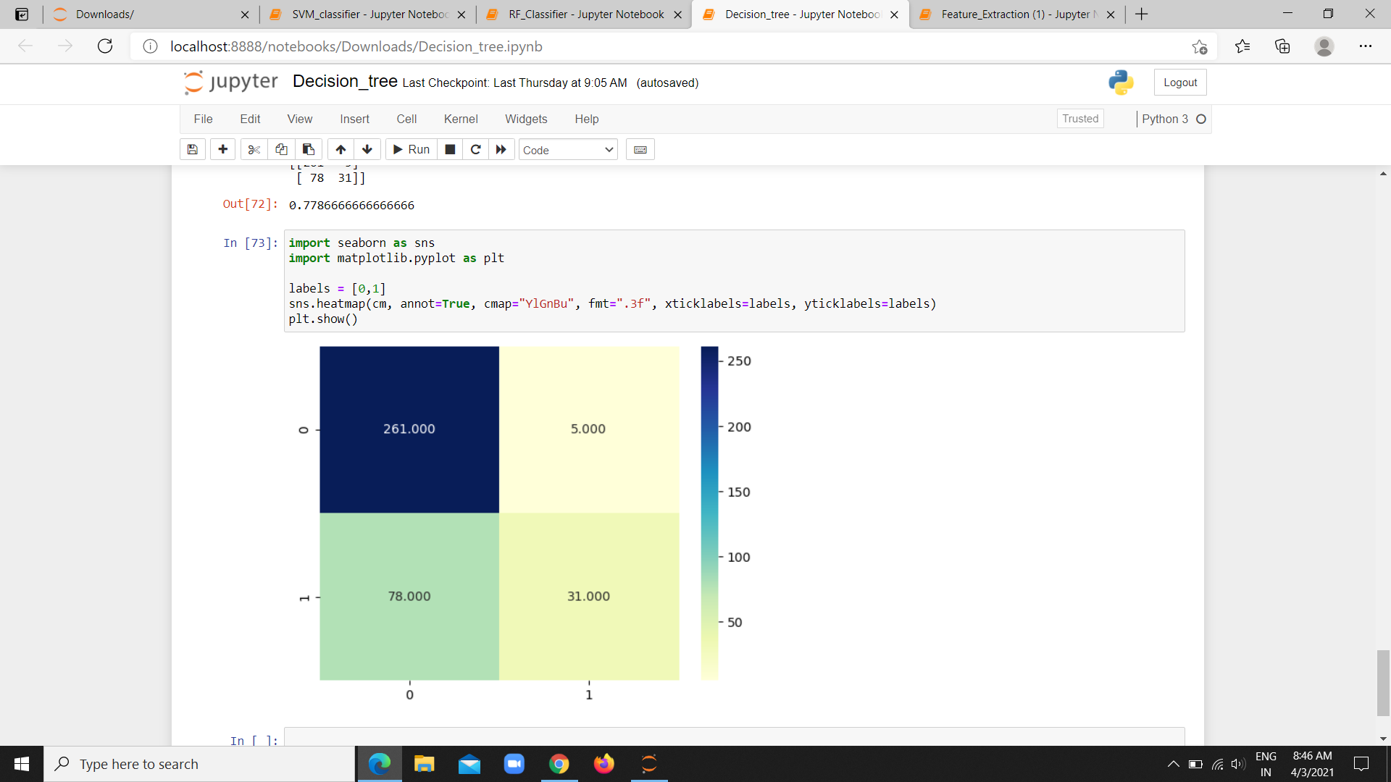
SCREEN SHOTS
25

Slide 26
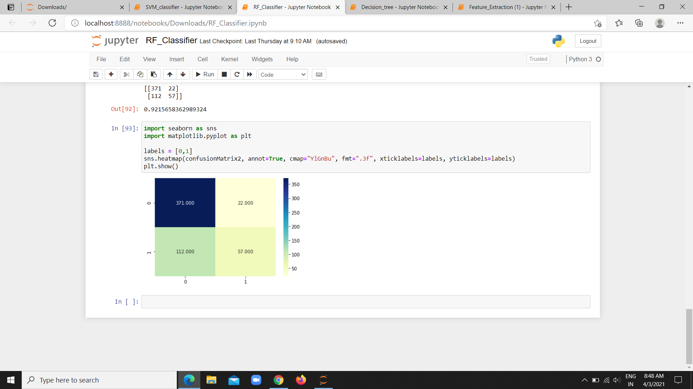
26

Slide 27
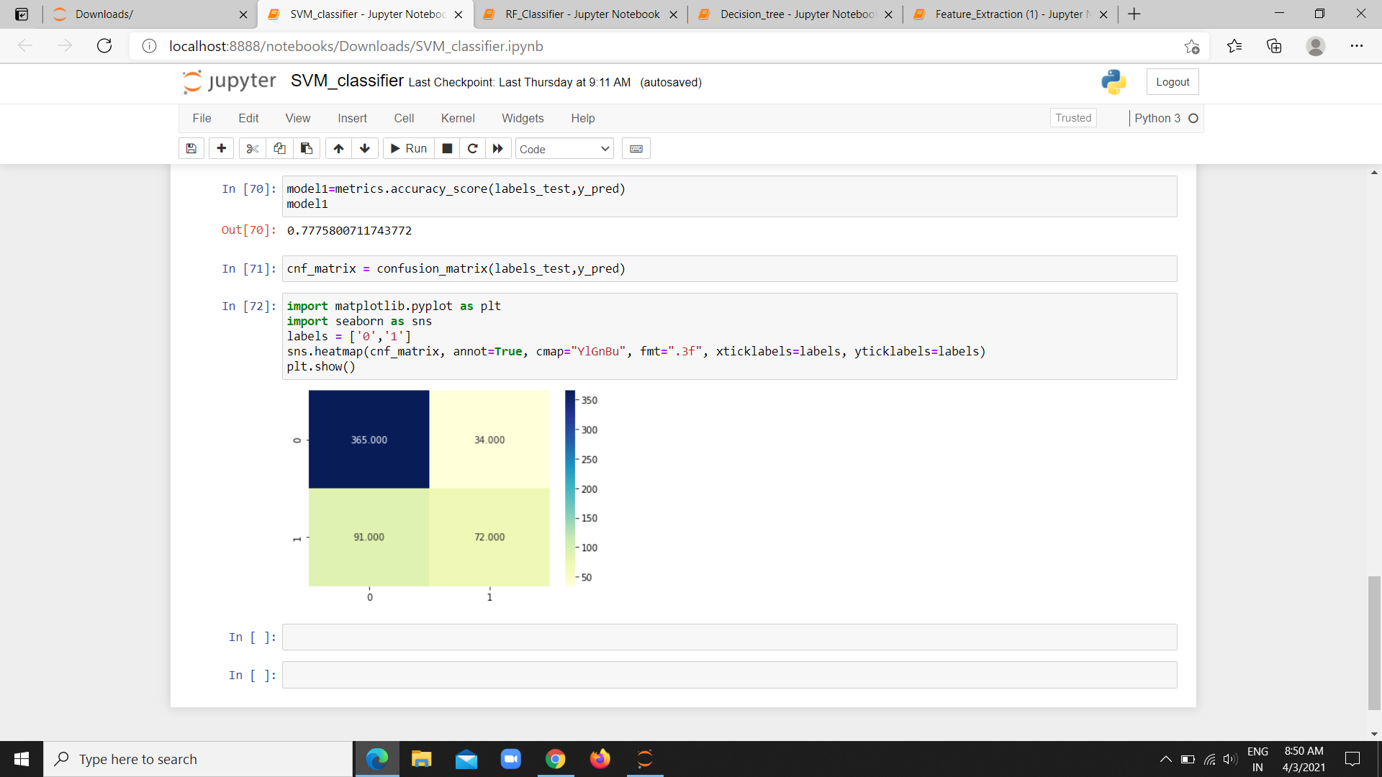
27

Slide 28
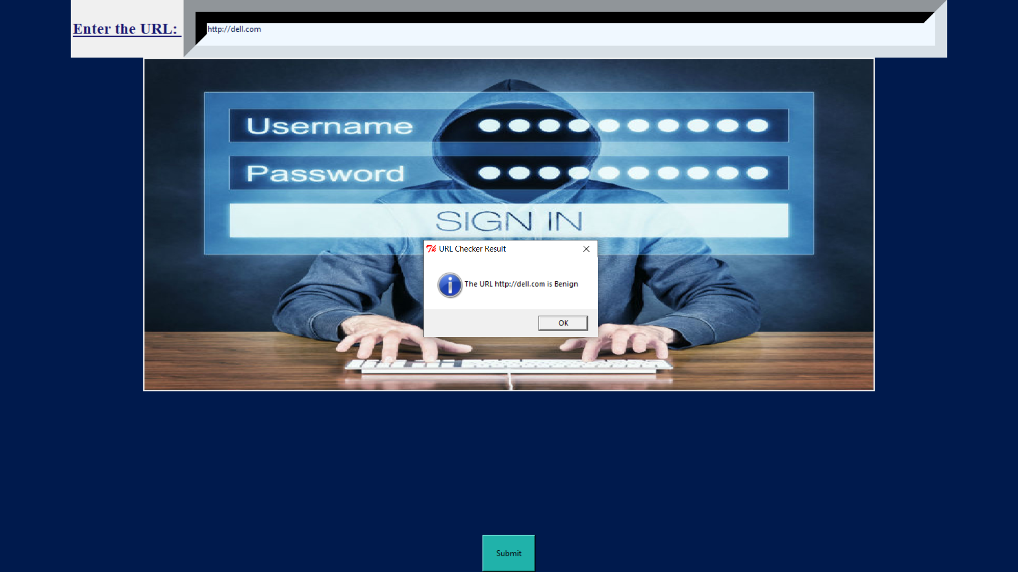
28

Slide 29
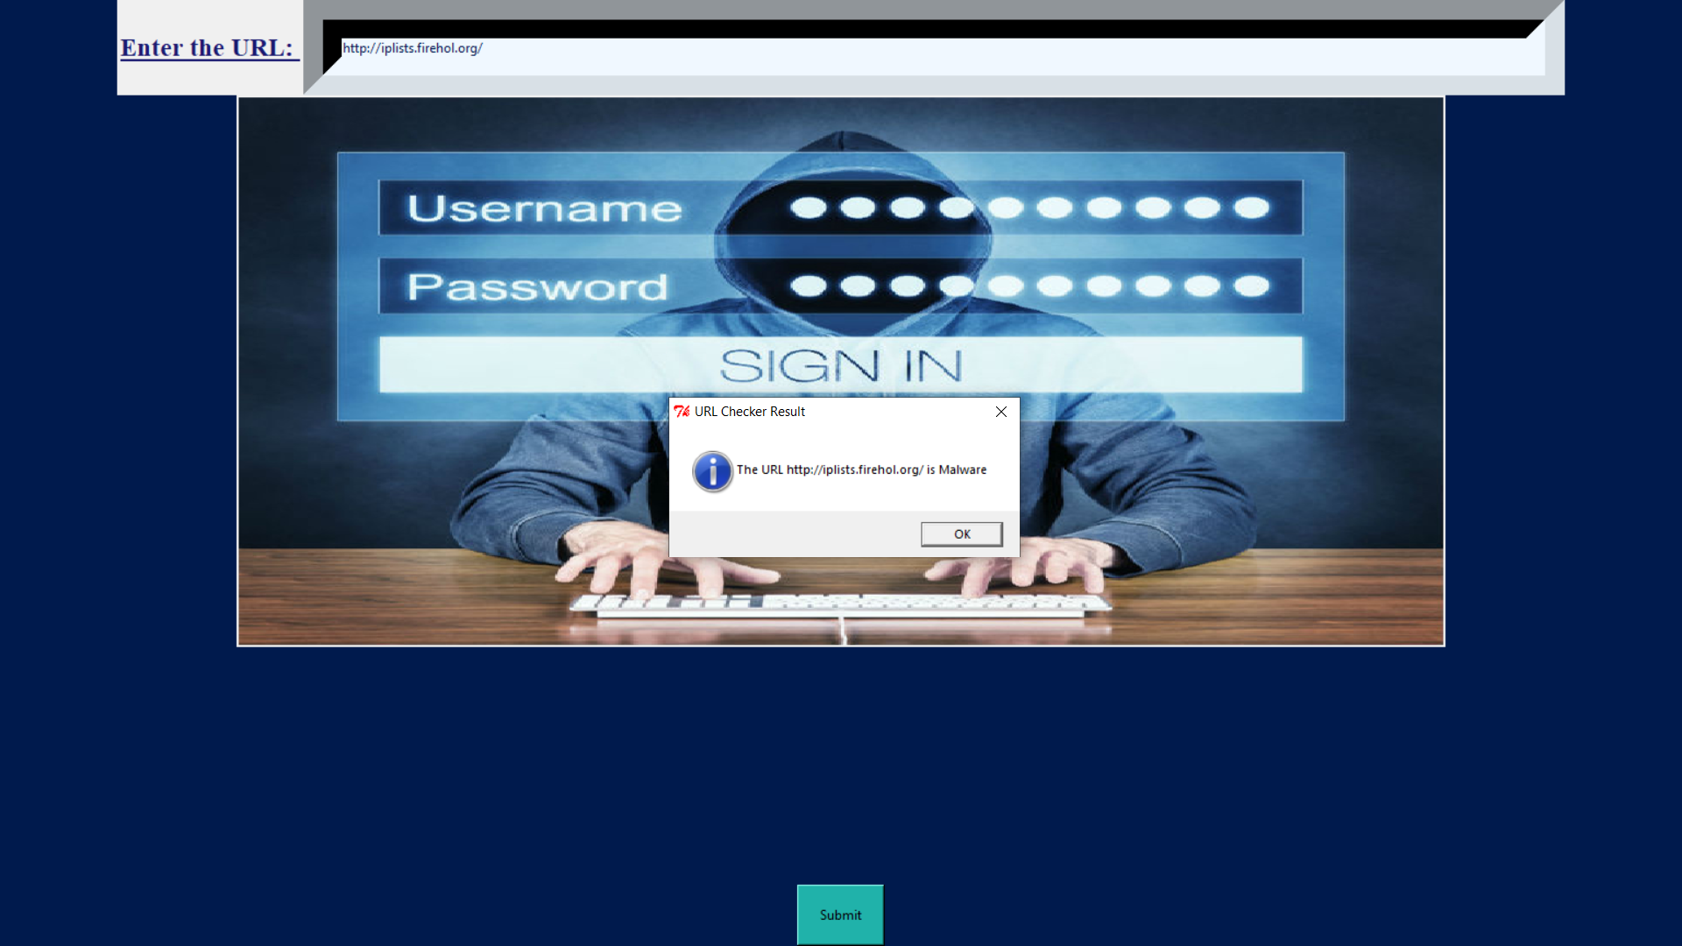
29

Slide 30
Conclusion :
Finally, phishing attacks are a major problem. It is important that they are countered. The work reported in this thesis indicates how understanding of the nature of phishing may be increased and provides a method to identify phishing problems in systems. It also contains a prototype of a system that catches those phishing attacks that evaded other defences, i.e. those attacks that have “slipped through the net”. An original contribution has been made in this important field, and the work reported here has the potential to make the internet world a safer place for a significant number of people.
30

Slide 31
Future Work:
In the future we will provide some technical solutions by improving the efficiency of spam filters. By which too many mails are classified correctly and properly. By this legitimate user can surf the internet with less fear.Although the use of URL lexical features alone has been shown to result in high accuracy (97%), phishers have learned how to make predicting a URL destination difficult by carefully manipulating the URL to evade detection. Therefore, combining these features with others, such as host, is the most effective approach .For future enhancements, we intend to build the phishing detection system as a scalable web service which will incorporate online learning so that new phishing attack patterns can easily be learned and improve the accuracy of our models with better feature extraction.
32

Slide 32
Publication:
This project was published as a paper in international journal of creative
research thoughts on 28.03.2021 by Giriswarna R and Harini P
Published issue : Vol 9 issue 3, March 2021
Link : https://ijcrt.org/track.php?r_id=204951
31

Slide 33
Reference :
6. Ram B.Basnet , Andrew H.Sung , “ Learning to detect Phishing URLs”, IEEE,2014.
7. Khonji,Iraqi,Andy Jones ,”Phishing Detection: A Literature Survey “,IEEE-13(4), 2013 .
8. M. Karabatak and T. Mustafa,”Performance comparison of classifiers on reduced phishing website dataset”,IEEE-18(7), 2018.
9. Wang Tao, Yu Shun Zheng, Xie Bailin,”A Novel Framework for learning to Detect Malicious web Pages” , IEEE,2010
10. Ping Yi,Yuxiang Guan,Futai Zou,Yao Yao, Wei Wang, and Ting Zhu,”Web Phishing Detection Using a Deep Learning Framework” , IEEE, 2018.
1. J. Shad and S. Sharma, “A Novel Machine Learning Approach to Detect Phishing Websites Jaypee Institute of Information Technology,” IJRET-9(4), 2018.
2. Wen Zhang, Yu-Xin Ding, Yan Tang, Bin Zhao, ”Malicious web Page detection based on online learning algorithm”, IEEE-10(11) 2011.
3. Birhanu Eshete, Adolfo Villafiorita , and Komminist Weldemariam,”Holistic Analysis and Detection of Malicious Web pages” ,ICSPCS(106),2012.
4. S. Marchal, J. Francois, R. State, and T. Engel, “Phish Score: Hacking phishers’ minds,” Proc. 10th Int. Conf. Netw. Serv. Manag. CNSM 2014, pp. 46–54, 2015.
5. A. A. Ahmed and N. A. Abdullah, “Real time detection of phishing websites,” 7th IEEE Annu. Inf. Technol. Electron. Mob. Commun. Conf. IEEE IEMCON , 2016.
33

Slide 34
THANK YOU

